Slide 1
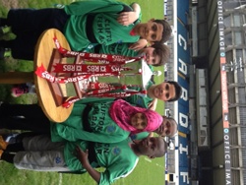
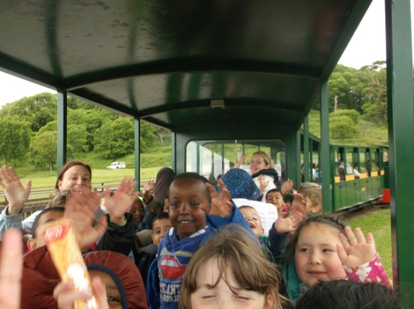
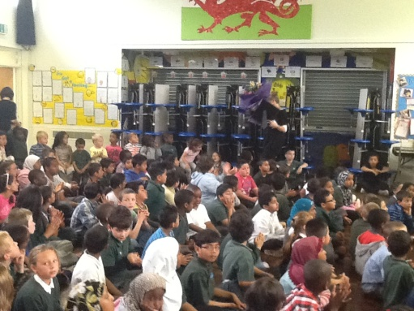
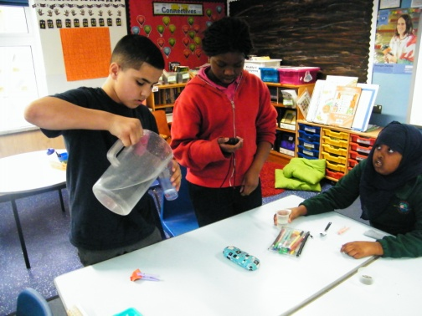
Adamsdown Primary School
Caring, Sharing and Learning Together.

Slide 2
Our Aim
We aim to ensure that every single child who
attends Adamsdown Primary is given the
opportunity to achieve their absolute best,
academically and socially, so that they are able to
get the most from their next stage of transferring to
High School, and then later for their working life in the
wider community. It is our intention to equip each one
to become a valued and valuable member of society;
to enjoy themselves and to continue to learn
throughout their lives using the skills they have
learned during their time at Adamsdown Primary.

Slide 3
Inner City School
Adamsdown Primary School is an inner city school situated on the south side of the city.

Slide 4
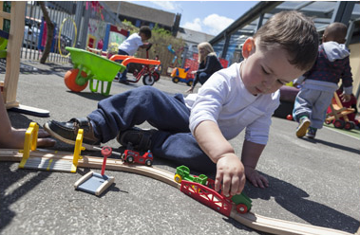
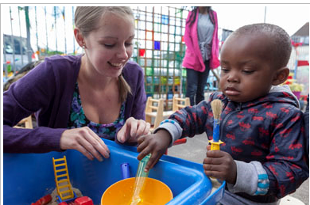
Flying Start
Flying Start is a Welsh Government funded programme which is targeted at children aged 0-3 years 11 months and their families who live in certain areas of Cardiff defined by post code. It is well recognised that children's early years are an important period and experiences at this time impact greatly on children's future development - so it is very important to get it right.

Slide 5
First Languages
We have 25 Languages in our school, such as:
Czech
Urdu
Somali
Bengali
Mandarin
Polish
Slovak
Afrikaans
Portuguese
Arabic
Swahili
Shona
Krio
Teginian
Mongolian
Punjabi
French

Slide 6
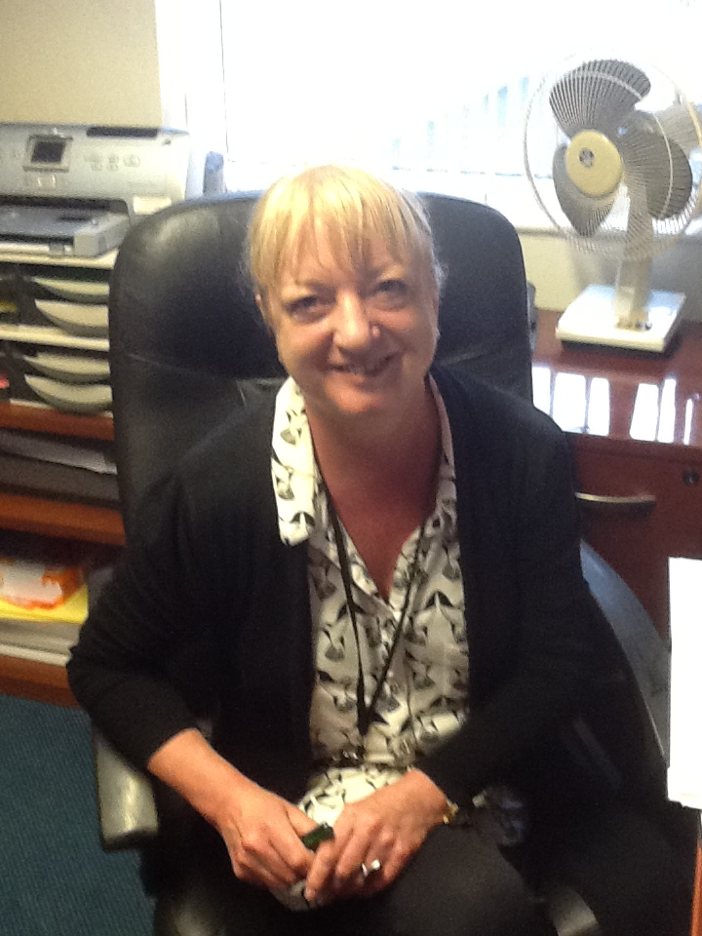
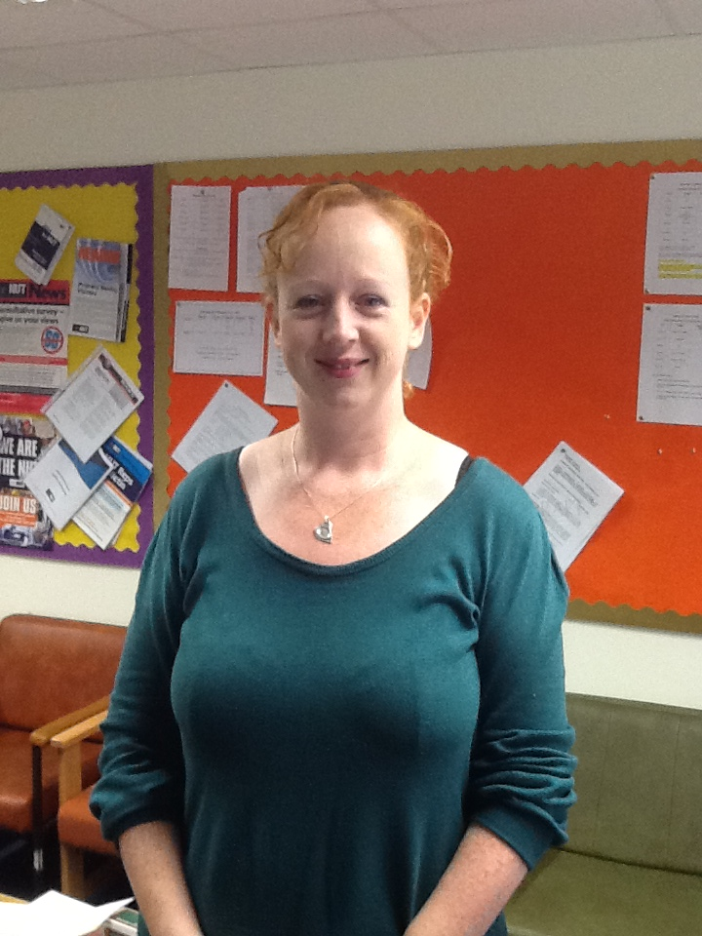
Classes and Teachers
The school currently has 11 classes and is phasing
towards becoming a two form entry primary school,
due to increase in catchment area and birth rate.
Head Teacher
Deputy Head Teacher
3 Senior Teachers
8 Class Teachers
2 Bilingual Teachers
13 Teaching Assistants
3 Bilingual Teaching Assistants

Slide 7
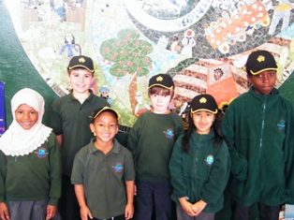
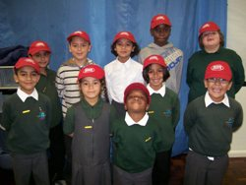
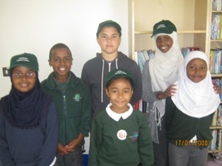
Children’s Committees
School Council
Eco Council
Food and Fitness Committee

Slide 8
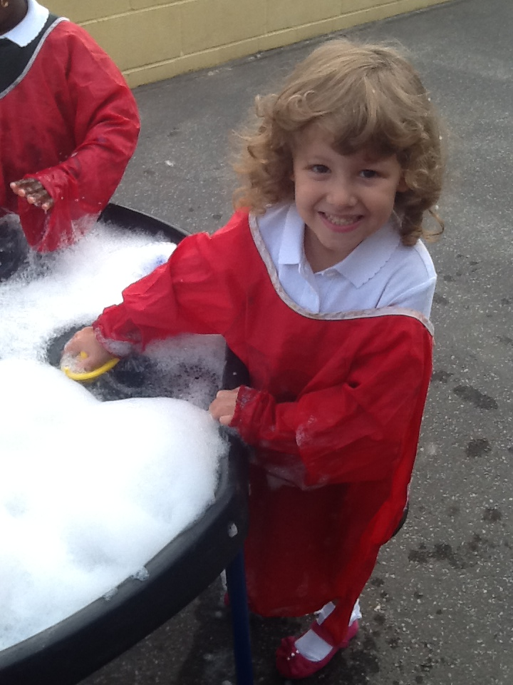
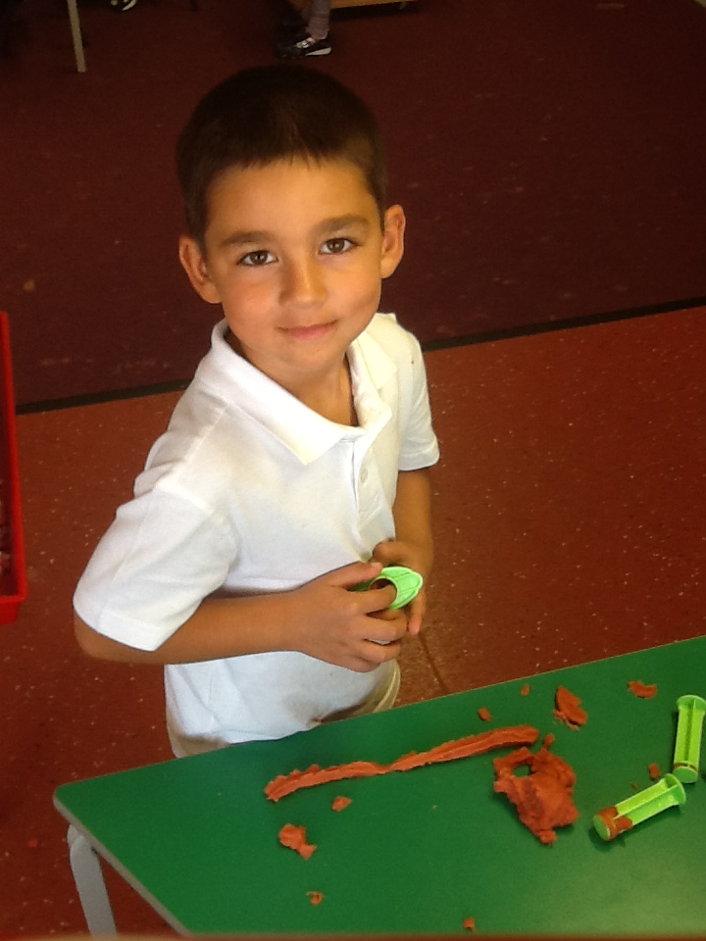
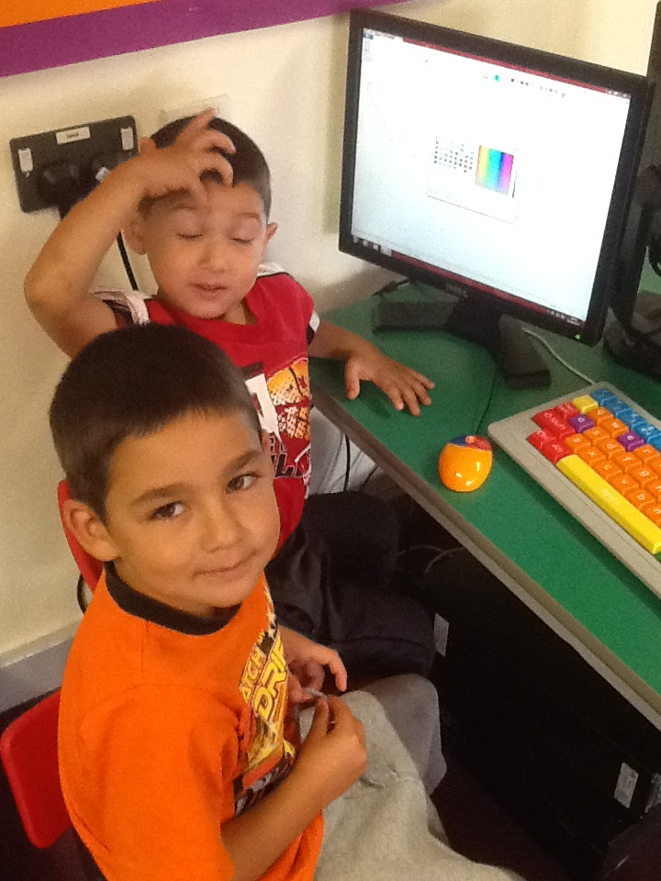
Curriculum
Foundation Phase – Nursery to Year 2
Children aged 3-7 follow a play based curriculum. Areas of Learning include:
Language, Literacy & Communication, Mathematical Development, Creative Development, Knowledge and Understanding of the World, Physical Development, Personal, Social and Emotional and Welsh Language.
Key Stage 2 – Year 3 to Year 6
Children aged 7-11 follow a skills based Curriculum. Areas of learning include: Literacy, Maths, Science, Welsh, P.E, History, Geography, Music, R.E, Art, P.S.E,I.C.T and D.T

Slide 9
Welsh Second Language
Welsh is taught from Nursery according to the curriculum.
It is also used regularly across the school in other areas in a incidental manner. Children respond to and follow the majority of instructions in welsh. They also are encouraged to use simple phrases and questions independently.

Slide 10
Average School Day
Foundation Phase
Key Stage 2
8:55 school starts.
9:10-9:30 Assembly
9:30-10:30 – Lesson 1
10:30-10:45 Playtime
10:45-12:00 – Lesson 2
12:00-13:05 – Lunchtime
13:05-14:00 – Lesson 3
14:00-15:00 – Lesson 4
15:00 - Home time
8:55 school starts.
9:10-9:30 Assembly
9:30-10:50 – Lesson 1
10:50-11:05 Playtime
11:05-12:00 – Lesson 2
12:00-12:25 – Lesson 3
12:25-13:05 – Lunchtime
13:05-14:00 – Lesson 4
14:00-15:00 – Lesson 5
15:00 - Home time

Slide 11
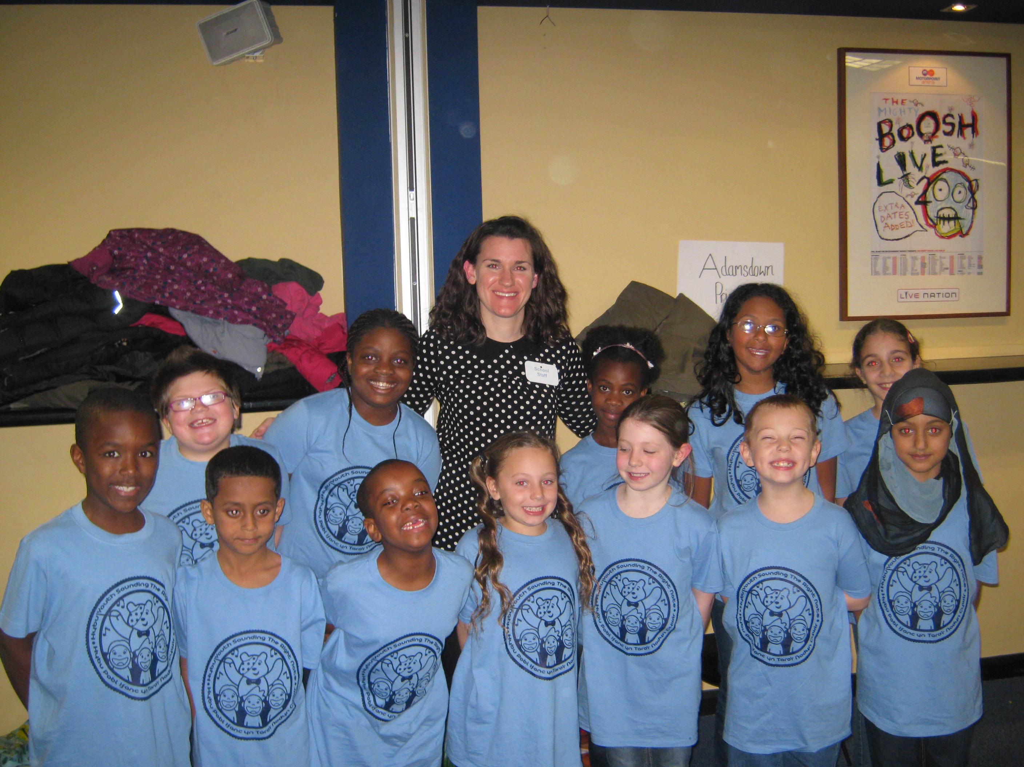
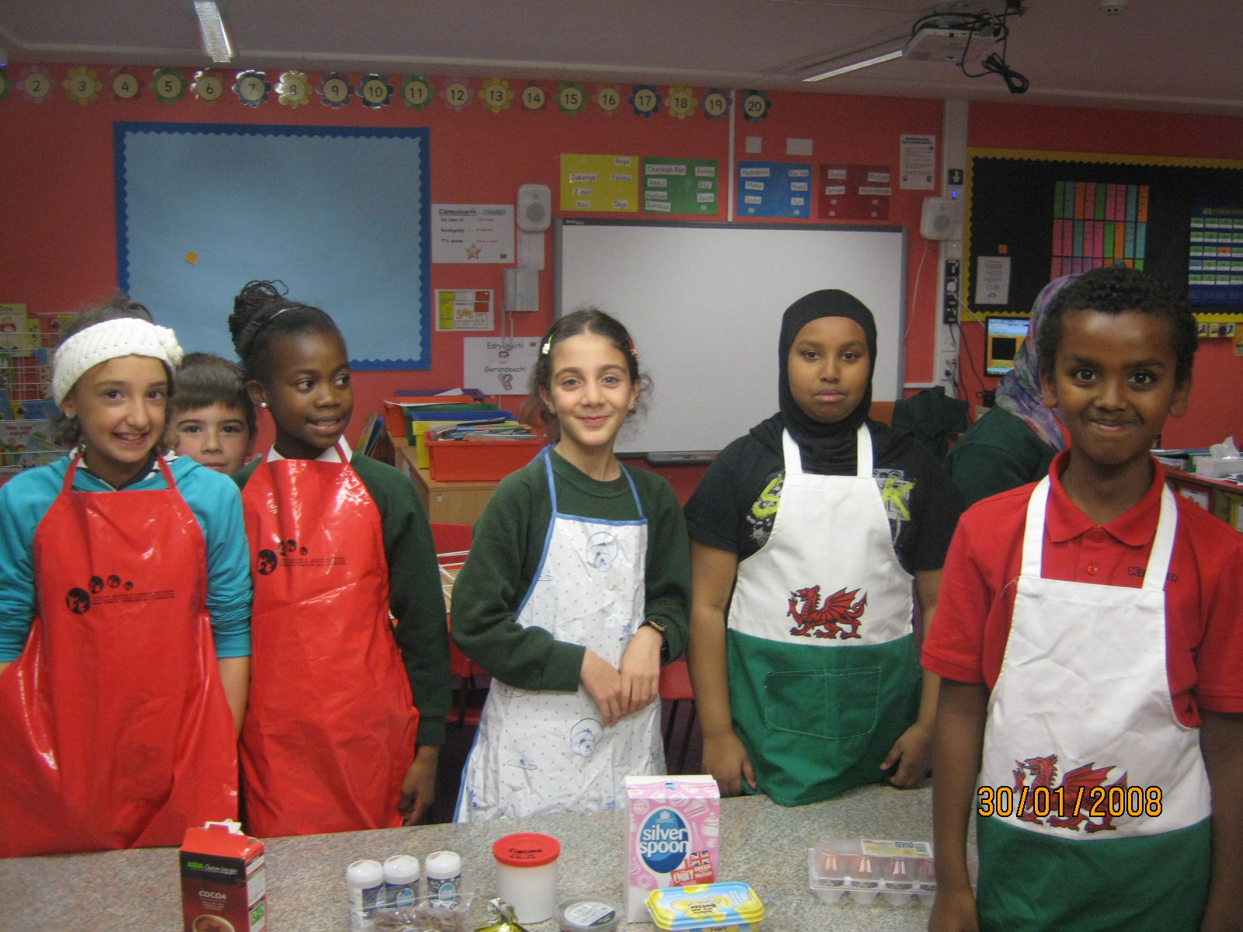
After School Clubs
Boys Football
Girls Football
Craft Club
Choir
Cookery Club
Story Club
Lego Club
Tag Rugby
Athletics
Cricket

