Slide 1
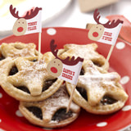
Christmas in Scotland
Made by pupils at Echt primary, aberdeenshire

Slide 2
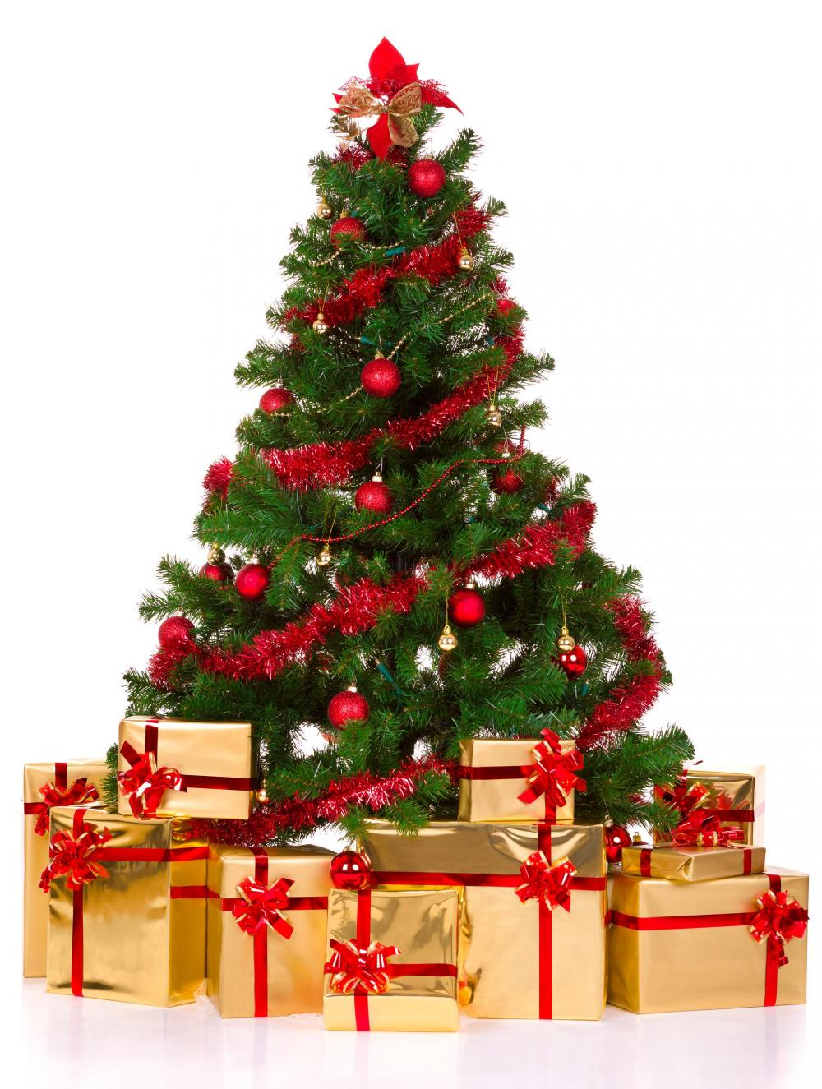
Scottish Christmas Trees

Slide 3
Why we have trees?
Like other countries we also have Christmas trees
Almost half of Scotland has been covered with trees
Do you know why we put trees in our house?
Because for us santa puts presents under our trees
And we cover our trees with decorations
Some people go out get there own decorations like pine cones hollys sticks but some people get sticks and make decorations out of them for fun (and for not spending money)
We either put a fairy on the top or a star

Slide 4
History of Christmas trees
Back in the Victorian times Queen Victoria married prince Albert. Thats when Christmas trees where born in Britan.
In 1842 a newspaper advert for Christmas trees was made to know about how Germans use it and how Britain can use it.
An illustrated book called the Christmas tree was about their use and their ideas. And their first ever sale for Christmas trees was in 1844. Then it came to Scotland.

Slide 5
Christmas Decorations
THE CHRISTMAS TREE
The Christmas tree was traditionally decorated with:
Apples, nuts and other foods. In the 18th century it was covered in lots of candles.
Red and green are the traditional colours of Christmas in Scotland.

Slide 6
Christmas Decorations
In the weeks leading up to and during Christmas. People hang decorations such as : Baubles, tinsle, Christmas tree’s and roof decoration’s
We also decorate the outside of our homes, like putting lights on our roofs and putting light up statues in our gardens.

Slide 7
Scottish Christmas
Christmas was invented in 1560.

Slide 8
Yule
Christmas in Scotland used to be called Yule. A 1640 Act of the Parliament of Scotland abolished the "Yule vacation and all observation thereof in time coming“ – banning Christmas. Christmas in Scotland was observed very quietly because the Church of Scotland never put much emphasis on the tradition. Only in 1958 Christmas became a public holiday; boxing day became a public holiday in 1974.

Slide 9
Scottish traditions
Christmas is all about sharing. But the
best thing is the fireball swinging and all the fireworks.
Christmas is that time of year
about celebrating Jesus’ birth.

Slide 10
Scottish traditions
22% of children
In Scotland don’t get a Christmas
tree to decorate
or get any presents but 78% see the
traditions and have a good time.

Slide 11
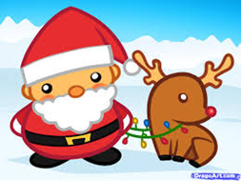
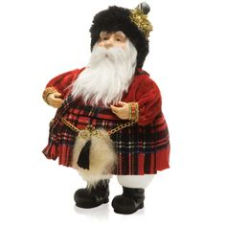
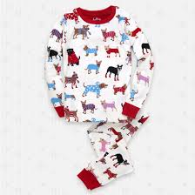
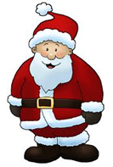
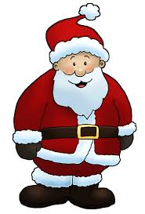
Scottish Christmas clothing
Children come down in their pyjamas on Christmas morning.
Santa wears a red coat and some black boots.

Slide 12
The Robin Sang by Sheena Blackhall
Christmas Songs
Click here to hear Sheena Blackhall singing some Scottish Christmas songs!
Ma Bonnie

Slide 13
In 1855 William H. Cummings adapted Felix Mendelssohns Hark! The Herald Angels Sing

Slide 14
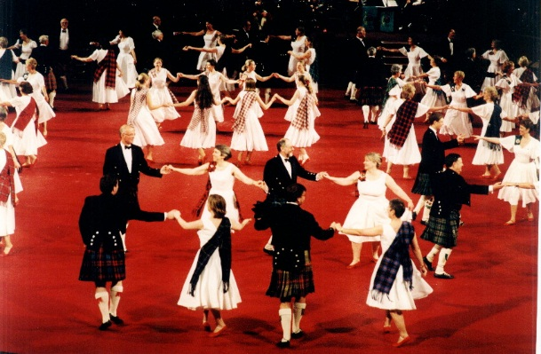
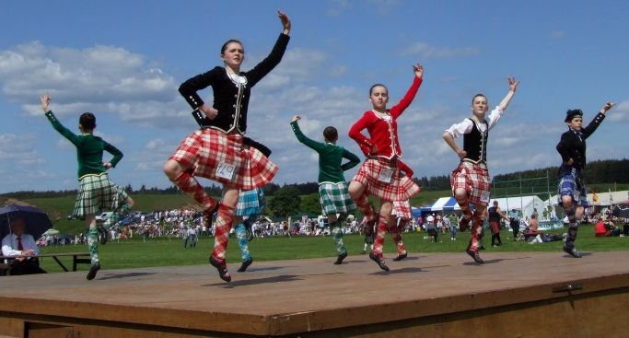
SCOTTISH DANCING
Scottish dancers

Slide 15
SCOTTISH DANCES
The Gay Gordons
Strip the Willow
The Britannia two step
The Sausage machine
The Highland Schottische
Lucky Seven
The Flying Scotsman
The Cumberland Square Eight
The Canadian or Highland Barn Dance

Slide 16
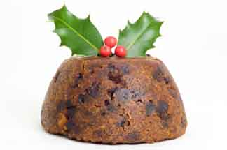
Traditional Scottish Christmas Food

Slide 17
Scottish Christmas Dinner
Main courses
Puddings
The traditional Scottish Christmas dinner includes : Roast turkey, served with roast potatoes, roasted parsnips, mealie, bacon rolls, chipolata sausages and of course GRAVY!.
The traditional Scottish Christmas pudding is usually served with brandy butter, rum sauce, custard or fresh cream. Other people may chose the similar dish of Clootie dumpling or Crannachan made with raspberries whisky, cream and oats.

Slide 18
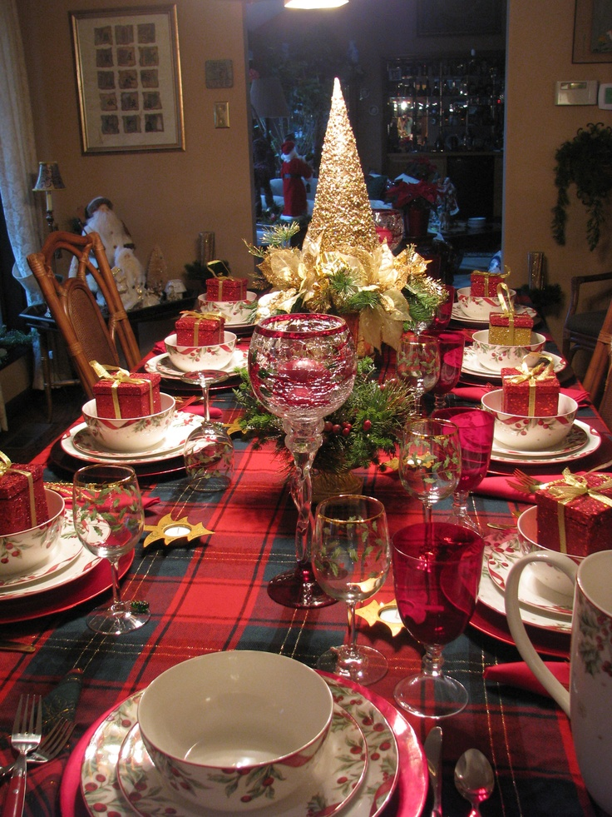
A laid Scottish Christmas Table

Slide 19
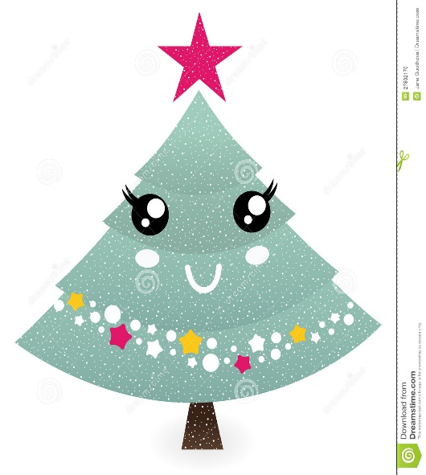
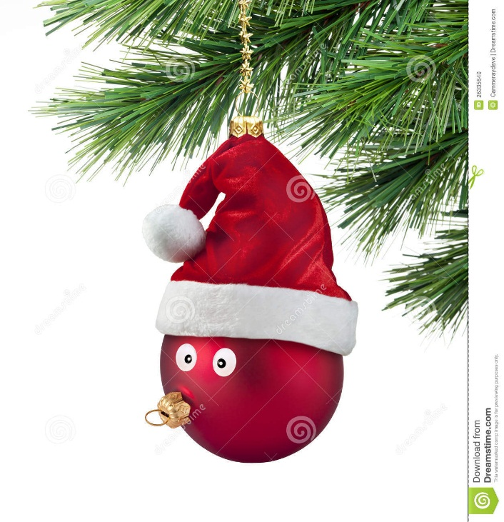
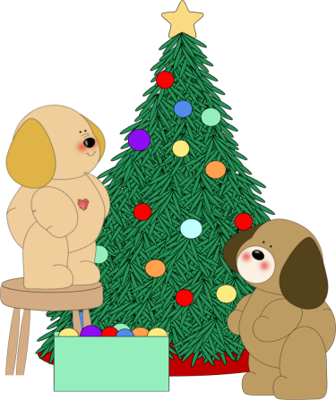
Thank you for watching

